Slide 1




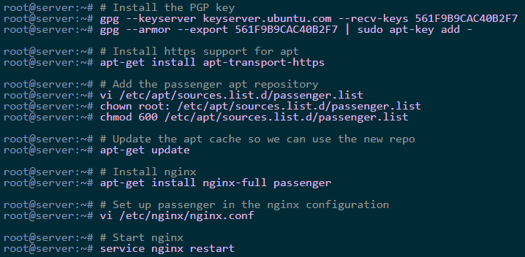


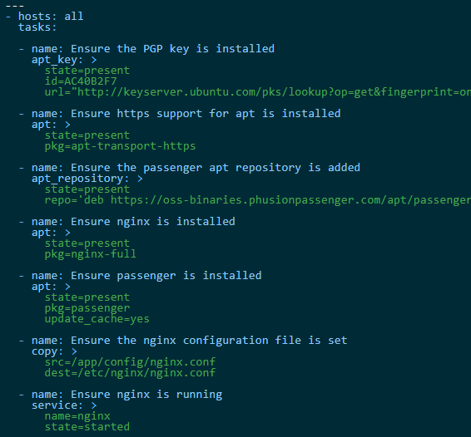
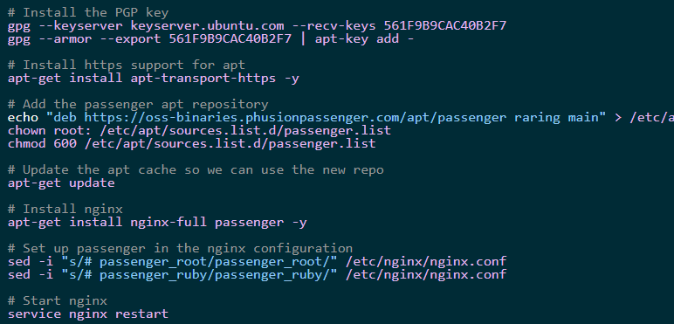
Not scalable to multiple servers
After Configuration Management
Ansible
Introduction
Before Configuration Management
Increased efficiencies, stability and control
Cost reduction
Enhanced system reliability
The ability to define and enforce formal policies and procedures
Greater agility and faster problem resolution, thus giving better quality of service.
Decreased risk and greater levels of security.
More efficient change management
Faster restoration of service.
Manual configuration
Creating shell scripts
Not Idempotent ( Cannot run multiple times and expect the same result )
Not capable of verifying server for correctness
Not capable of templating the configuration files
Repetitive tasks
Provisioning Environments
OS configuration and dependencies
Network and Firewall Configuration
Setting up Users/Groups, Security Authentication
Software Installation and Configuration
Software Deployments
Turn off monitoring/alerts
Run DB migrations
Deploy application code
Restart webserver
Turn on monitoring/alerts
Server Maintenance
SSH in to every server and restart a service
Update packages and dependencies
Patch security updates
Create backups
Resource Usage checks
Logs and Statistics monitoring
File system maintenance

Slide 2
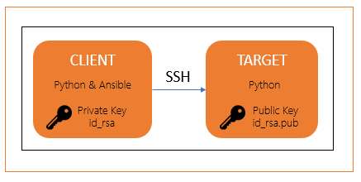




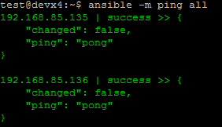

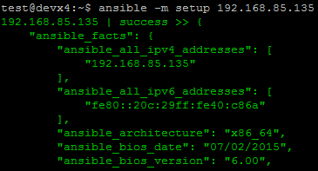

Installation of Ansible
Inventory
Ansible
Define how ansible will interact with remote hosts
Define logical group of managed nodes
Default location: /etc/ansible/hosts or –i <option>
Overview
Ansible Control Machine
Ansible Target Machine
[local]
127.0.0.1
[webservers]
web[1:5].example.com ansible_connection=ssh ansible_ssh_user=webadmin
[webserver:vars]
http_port=80
[dbservers]
db[01:03].example.com
oracledb_port=1521
[target-machine]
13.56.171.112
SSH
Configuration Management Tool created by Red Hat
Ansible is a radically simple IT automation engine that automates cloud provisioning, configuration management, application deployment, intra-service orchestration, and many other IT needs.
Open source program written in Python
Its configuration file, also called Playbook, is written in YAML
Agent-less – No need for agent installation and management
Uses SSH Connection to configure different nodes.
Large number of ready to use modules for system management
Configuration roll-back in case of error
Simple and human readable
Install packages below on the Client Machines
sudo apt-get install python-crypto python-keyczar
Install packages below on the Target Machines
sudo apt-get install python-yaml python-jinja2 python-paramiko python-crypto python-keyczar ansible
Create the key pair on the Client Machine and Copy the public key on the authorized_keys of the Target Machines
hosts
Ad-Hoc commands
Architecture
$ ansible {pattern} –m {module} –a “{options}” {flags}
Public/Private Cloud
SSH
Playbook
Inventory
Connection Plugins
Host1
Modules
API
Host2
Users
HostN
ANSIBLE AUTOMATION ENGINE

Slide 3
Ansible
file - Sets attributes of files
shell - Execute commands in nodes
Overview - Modules
# touch a file and add/remove some permissions
- file:
path: /etc/foo.conf
state: touch
mode: "u+rw,g-wx,o-rwx"
# create a directory if it doesn't exist
- file:
path: /etc/some_directory
state: directory
mode: 0755
name: Execute the command in remote shell
shell: “mkdir /tmp/samplefolder”
- name: Change the working directory to somedir/ before executing the command.
shell: somescript.sh >> somelog.txt
args:
chdir: somedir/
Modules
Files Modules
acl - Sets and retrieves file ACL information.
archive - Creates a compressed archive of one or more files or trees.
assemble - Assembles a configuration file from fragments
blockinfile - Insert/update/remove a text block surrounded by marker lines.
copy - Copies files to remote locations
fetch - Fetches a file from remote nodes
file - Sets attributes of files
find - Return a list of files based on specific criteria
ini_file - Tweak settings in INI files
iso_extract - Extract files from an ISO image
lineinfile - Ensure a particular line is in a file, or replace an existing line using a back-referenced regular expression.
patch - Apply patch files using the GNU patch tool
replace - Replace all instances of a particular string in a file using a back-referenced regular expression.
stat - Retrieve file or file system status
synchronize - A wrapper around rsync to make common tasks in your playbooks quick and easy.
tempfile - Creates temporary files and directories.
template - Templates a file out to a remote server
unarchive - Unpacks an archive after (optionally) copying it from the local machine.
xattr - set/retrieve extended attributes
xml - Manage bits and pieces of XML files or strings
copy - Copies files to remote locations
stat - Retrieve file or file system status
# Copies the foo.conf from the client to the target machine
- copy:
src: /srv/myfiles/foo.conf
dest: /etc/foo.conf
owner: foo
group: foo
mode: 0644
# Obtain the stats of /etc/foo.conf
- stat:
path: /etc/foo.conf
register: foostatus
template - Templates a file out to a remote server
fetch - Fetches a file from remote nodes
# Create a file.conf from a foo.j2 template
- template:
src: /mytemplates/foo.j2
dest: /etc/file.conf
owner: bin
group: wheel
mode: 0644
# Store file into /tmp/fetched/host.example.com/tmp/somefile
- fetch:
src: /tmp/somefile
dest: /tmp/fetched

Slide 4

Ansible
defaults/vars
Simple YAML format
Precedence
-e variables
Variables defined in inventory
Variables defined in facts
Role defaults
Contains the role variables
files
Contains regular files/scripts that are needed to be transferred to the hosts that you are configuring
Overview - Playbooks
Playbook
Declare configurations of more complex multi-system environments
Expressed in YAML language
Consists of one or more plays in a list
files
index.html
script.sh
username: ‘john.smith’
db_port: 1521
db_driver: oracle.jdbc.OracleDriver
db_conn: 'oracle:thin:@’
LD_LIBRARY_PATH: '/usr/share/oracle/v14'
changelog_file: 'db_update.xml'
tasks
Are executed in order against all machines matched by host pattern
Each tasks executes a module with specific options
Modules are idempotent in order to bring the system to desired state
ansible-playbook
roles
role1
defaults
handlers
Notifications may be triggered at the end of each block of tasks whenever a change has been made on the remote system
Handlers are referenced by name
main.yml
handlers
tasks:
name: {task name}
{module}: {options}
main.yml
files
index.html
---
- hosts: target_machine
tasks:
- name: template configuration file
template:
src: template.j2
dest: /etc/foo.conf
notify:
- restart apache
handlers:
- name: restart apache
service: name=apache state=restarted
templates
Templates are interpreted by jinja2
Stub out files
Fill variables in differently depending on conditions
Powerful conditionals
Loops and iterators
script.sh
tasks
main.yml
templates
provisioningscript.sh.j2
role2
export dbusername=“{{ username }}”
export changelogfile=“{{ LD_LIBRARY_PATH }}/{{ changelog_file}}”
playbook.yml

Slide 5
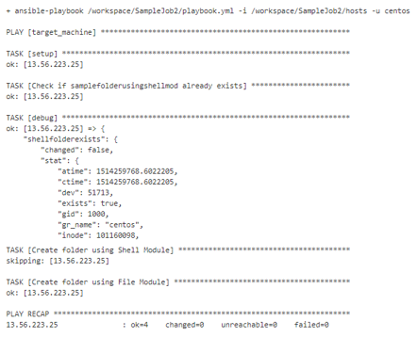
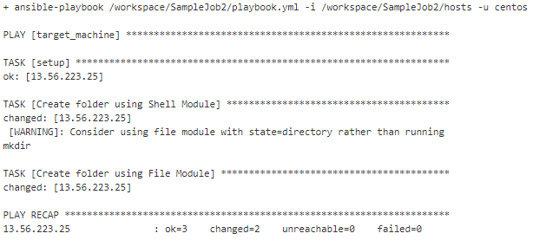
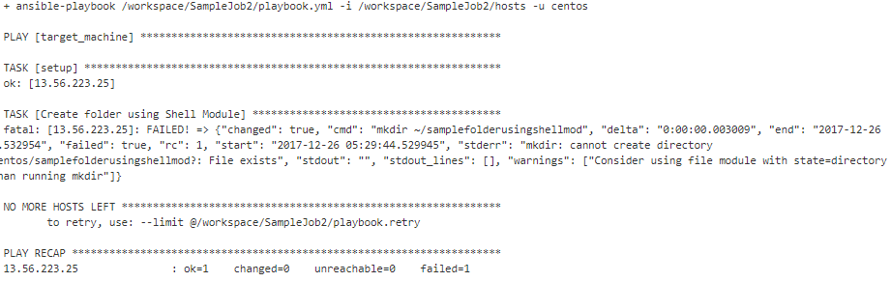
Ansible
Minimal Playbook Setup
Adding Idempotency
ansible-playbook
playbook.yml
Overview - Playbooks
hosts
---
- hosts: target_machine
tasks:
- name: Check if shellmodulefolder already exists
stat:
path: "~/shellmodulefolder"
register: shellfolderexists
- debug: var=shellfolderexists
- name: Create folder using Shell Module
shell: "mkdir ~/shellmodulefolder"
when: shellfolderexists.stat.exists!=true
- name: Create folder using File Module
file:
state: directory
path: "~/filemodulefolder"
Playbook
[target-machine]
13.56.223.25
Declare configurations of more complex multi-system environments
Expressed in YAML language
Consists of one or more plays in a list
playbook.yml
---
- hosts: target-machine
tasks:
- name: Create folder using Shell Module
shell: "mkdir ~/shellmodulefolder"
- name: Create folder using File Module
file:
state: directory
path: "~/filemodulefolder"
ansible-playbook
roles
role1
defaults
main.yml
handlers
main.yml
files
index.html
script.sh
tasks
main.yml
templates
provisioningscript.sh.j2
role2
playbook.yml

Slide 6
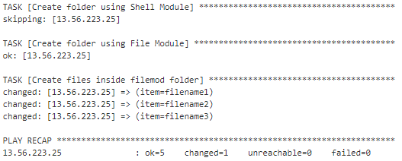
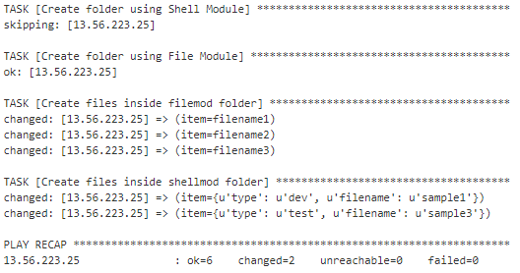
Ansible
Creating loop in tasks
With multiple reference subkeys
playbook.yml
playbook.yml
Overview - Playbooks
---
- hosts: target_machine
tasks:
- name: Check if shellmodulefolder already exists
stat:
path: "~/shellmodulefolder"
register: shellfolderexists
- debug: var=shellfolderexists
- name: Create folder using Shell Module
shell: "mkdir ~/shellmodulefolder"
when: shellfolderexists.stat.exists!=true
- name: Create folder using File Module
file:
state: directory
path: "~/filemodulefolder“
- name: Create files inside filemod folder
file:
state: touch
path: "~/samplefolderusingfilemod/{{ item }}"
with_items:
- filename1
- filename2
- filename3
……………
- name: Create folder using Shell Module
shell: "mkdir ~/shellmodulefolder"
when: shellfolderexists.stat.exists!=true
- name: Create folder using File Module
file:
state: directory
path: "~/filemodulefolder“
- name: Create files inside filemod folder
file:
state: touch
path: "~/samplefolderusingfilemod/{{ item }}"
with_items:
- filename1
- filename2
- filename3
- name: Create files inside shellmod folder
file:
state:touch
path:"~/samplefolderusingshellmod/{{ item.filename }}_{{ item.type }}"
with_items:
- { filename: 'sample1', type: 'dev' }
- { filename: 'sample3', type: 'test' }
Playbook
Declare configurations of more complex multi-system environments
Expressed in YAML language
Consists of one or more plays in a list
ansible-playbook
roles
role1
defaults
main.yml
handlers
main.yml
files
index.html
script.sh
tasks
main.yml
templates
provisioningscript.sh.j2
role2
playbook.yml

Slide 7
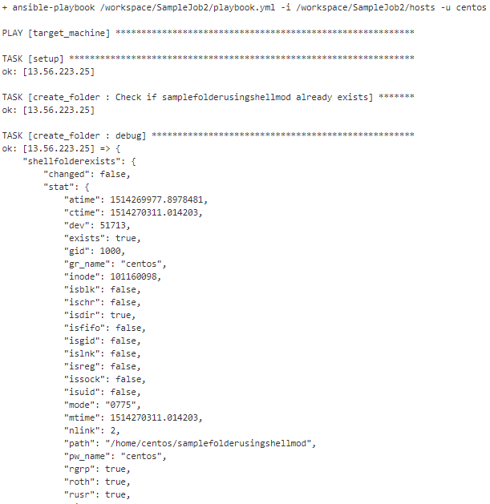

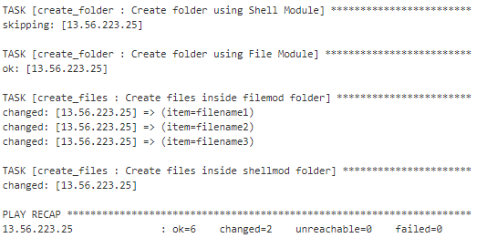
Ansible
Creating Roles
Overview - Playbooks
ansible-playbook
roles
Playbook
create_folder
Declare configurations of more complex multi-system environments
Expressed in YAML language
Consists of one or more plays in a list
tasks
main.yml
- name: Check if shellmodulefolder already exists
stat:
path: "~/shellmodulefolder"
register: shellfolderexists
- name: Create folder using Shell Module
shell: "mkdir ~/shellmodulefolder"
when: shellfolderexists.stat.exists!=true
- name: Create folder using File Module
file: state=directory path="~/filemodulefolder"
ansible-playbook
roles
role1
defaults
create_files
main.yml
tasks
main.yml
handlers
- name: Create files inside filemod folder
file: state=touch path="~/samplefolderusingfilemod/{{ item }}"
with_items:
- filename1
- filename2
- filename3
- name: Create files inside shellmod folder
file: state=touch path="~/samplefolderusingshellmod/{{ item.filename }}_{{ item.type }}"
with_items:
- { filename: 'sample1', type: 'dev' }
- { filename: 'sample2', type: 'test' }
main.yml
files
index.html
script.sh
tasks
main.yml
templates
provisioningscript.sh.j2
playbook.yml
role2
---
- hosts: target_machine
roles:
- { role: create_folder, tags: ["create_folder"]}
- { role: create_files, tags: ["create_files"]}
playbook.yml

Slide 8
Ansible
Parameterizing Tasks and Variables file
Overview - Playbooks
ansible-playbook
roles
Playbook
create_folder
Declare configurations of more complex multi-system environments
Expressed in YAML language
Consists of one or more plays in a list
tasks
main.yml
- name: Check if {{ shellfoldername }} already exists
stat:
path: "~/{{ shellfoldername }}"
register: shellfolderexists
- name: Create folder using Shell Module
shell: "mkdir ~/{{ shellfoldername }}"
when: shellfolderexists.stat.exists!=true
- name: Create folder using File Module
file:
state: directory
path: "~/{{ filefoldername }}"
ansible-playbook
roles
role1
defaults
main.yml
handlers
main.yml
defaults
files
main.yml
index.html
script.sh
shellfoldername: 'samplefolderusingshellmod'
filefoldername: 'samplefolderusingfilemod'
tasks
create_files
main.yml
tasks
templates
main.yml
provisioningscript.sh.j2
playbook.yml
role2
---
- hosts: target_machine
roles:
- { role: create_folder, tags: ["create_folder"]}
- { role: create_files, tags: ["create_files"]}
playbook.yml

Slide 9
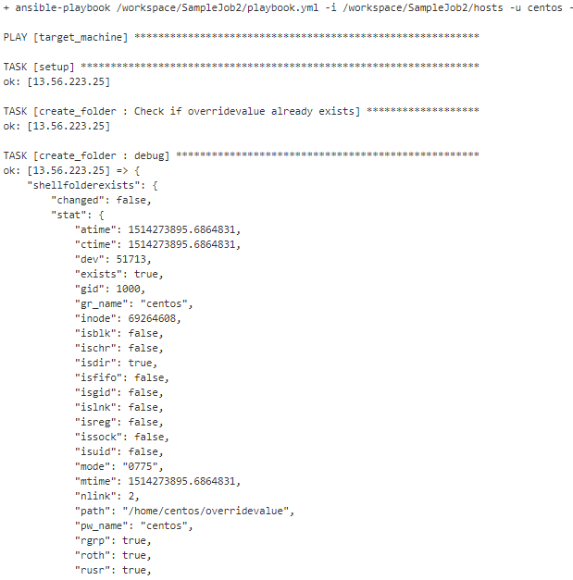
Ansible
Overriding Values
Overview - Playbooks
ansible-playbook
roles
Playbook
create_folder
Declare configurations of more complex multi-system environments
Expressed in YAML language
Consists of one or more plays in a list
tasks
main.yml
- name: Check if {{ shellfoldername }} already exists
stat:
path: "~/{{ shellfoldername }}"
register: shellfolderexists
- name: Create folder using Shell Module
shell: "mkdir ~/{{ shellfoldername }}"
when: shellfolderexists.stat.exists!=true
- name: Create folder using File Module
file:
state: directory
path: "~/{{ filefoldername }}"
ansible-playbook
roles
role1
defaults
main.yml
handlers
main.yml
defaults
files
main.yml
index.html
script.sh
shellfoldername: 'samplefolderusingshellmod'
filefoldername: 'samplefolderusingfilemod'
tasks
create_files
main.yml
tasks
templates
main.yml
provisioningscript.sh.j2
playbook.yml
role2
---
- hosts: target_machine
roles:
- { role: create_folder, tags: ["create_folder"]}
- { role: create_files, tags: ["create_files"]}
playbook.yml

Slide 10
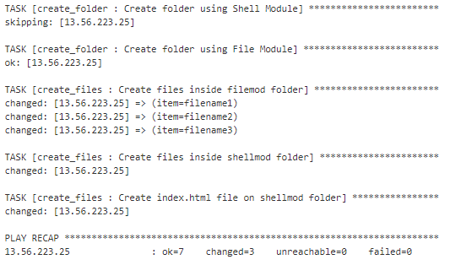

Ansible
Using templates
templates
ansible-playbook
index.html.j2
Overview - Playbooks
<html>
<h1>{{ sampleapp }}</h1>
</html>
roles
Playbook
create_folder
Declare configurations of more complex multi-system environments
Expressed in YAML language
Consists of one or more plays in a list
tasks
playbook.yml
main.yml
---
- hosts: target_machine
roles:
- { role: create_folder, tags: ["create_folder"]}
- { role: create_files, tags: ["create_files"]}
defaults
ansible-playbook
main.yml
create_files
roles
defaults
role1
main.yml
defaults
sampleapp: 'HelloWorld Web application'
main.yml
tasks
handlers
main.yml
main.yml
- name: Create files inside filemod folder
file:
state: touch
path: "~/samplefolderusingfilemod/{{ item }}"
with_items:
- filename1
- filename2
- filename3
- name: Create files inside shellmod folder
file:
state: touch
path: "~/samplefolderusingshellmod/samplefile"
with_items:
- {filename: 'sample1', type: 'dev'}
- {filename: 'sample3', type: 'test'}
- name: Create index.html file on shellmod folder
template:
src: "../templates/index.html.j2“
dest: "~/samplefolderusingshellmod/index.html"
files
index.html
script.sh
tasks
main.yml
templates
provisioningscript.sh.j2
role2
playbook.yml

Slide 11
Ansible
Overview – Ansible Vault
Vault
vault_pass.txt
passwords.yml
Allows keeping encrypted data in source control
Creating encrypted files
$ ansible-vault create vault.yml
Editing encrypted files
$ ansible-vault edit vault.yml
Encrypting unencrypted files
$ ansible-vault encrypt vault.yml
Decrypted encrypted files
$ ansible-vault decrypt vault.yml
Running ad-hoc or playbook with vault
$ ansible-playbook site.yml --vault-password-file ~/.vault_pass.txt
userpassword: ‘Password01’
dbpassword: ‘Password02’
apppassword: ‘Password03’
j7l5x7hGX5
$ export ANSIBLE_VAULT_PASSWORD_FILE=~/.vault_pass.txt $ ansible-vault encrypt vault.yml
passwords.yml
$ANSIBLE_VAULT;1.1;AES256
30343236353262353339623037393836333665613966376537306536373334323466313565646232
3435376636656536643665636364303830343635653230310a616531346336373962633439653364
64633935316133343466396461343861623039666165633763356632613334366235616463366235
3334393661616161330a633037636361353664373737376138613931343762366238633162343434
62346435326339666133346435393237396139306166383231653863646134313532386161306539
36613539643462613237386338383634376333316161363464393539666132313734353861366661
34626132366234656130353263386163626531373164623536313965356338376633343165613235

Slide 12
Sources
Overview
https://speakerdeck.com/tasdikrahman/introduction-to-ansible
https://www.slideshare.net/johnthethird/ansible-presentation-24942953
https://www.slideshare.net/StephaneManciot/ansible-44734246
https://www.slideshare.net/SureshKumar1612/ansible-presentation-66327456
https://afnog.github.io/sse/ansible/Ansible_Presentation.pptx
https://hvops.com/articles/ansible-vs-shell-scripts/
https://www.upguard.com/blog/5-configuration-management-boss
https://www.ansible.com/overview/how-ansible-works
http://docs.ansible.com/ansible/latest/modules_by_category.html
http://docs.ansible.com/ansible/latest/list_of_files_modules.html
https://docs.ansible.com/ansible/2.4/vault.html
https://gist.github.com/tristanfisher/e5a306144a637dc739e7

